Slide 1
GAN-based Image Inpainting
xyfJASON

Slide 2
CONTENTS
Introduction
Evaluation metrics
Models
https://github.com/geekyutao/Image-Inpainting
Context Encoder
GLCIC (GLGAN)
PGGAN
Contextual Attention (DeepFill v1)
EdgeConnect
DeepFill v2
Blind image inpainting
VCNet
Introduction
Training Data Generation
Method
Experiment
Thinking

Slide 3
1 INTRODUCTION

Slide 4
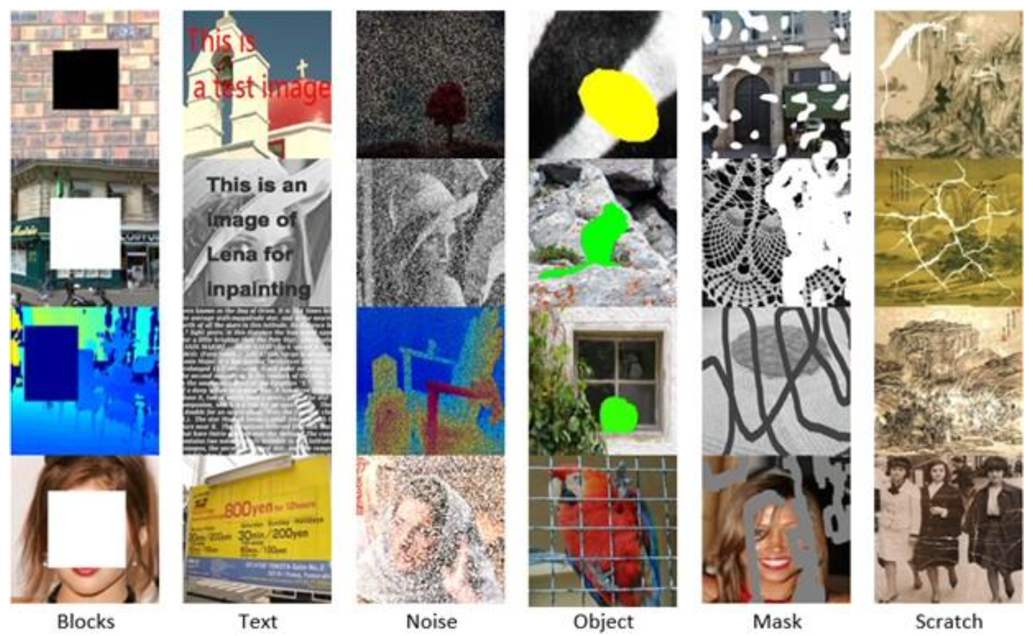
INTRODUCTION
Image source: Elharrouss, Omar, Noor Almaadeed, Somaya Al-Maadeed, and Younes Akbari. "Image inpainting: A review." Neural Processing Letters 51, no. 2 (2020): 2007-2028.

Slide 5
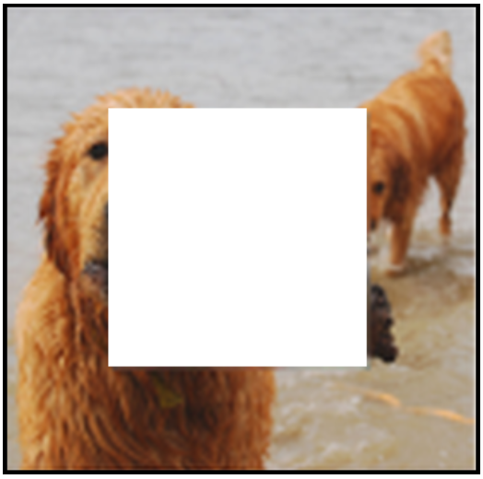
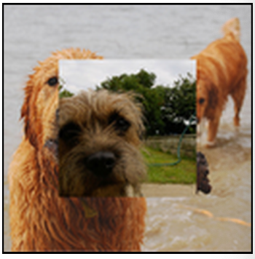
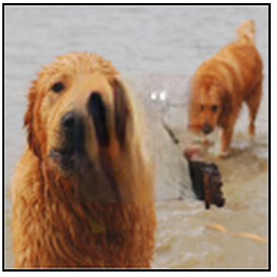
INTRODUCTION
Keys
如何得到全局一致性
High-level features, semantic
如何得到局部真实性
Low-level features, textures / shapes, pixel level
如何获取远处信息
与卷积操作的局部性相违背
Network structure
Loss function
Copy-and-paste
DL methods
(Context Encoder)

Slide 6
2 EVALUATION METRICS

Slide 7
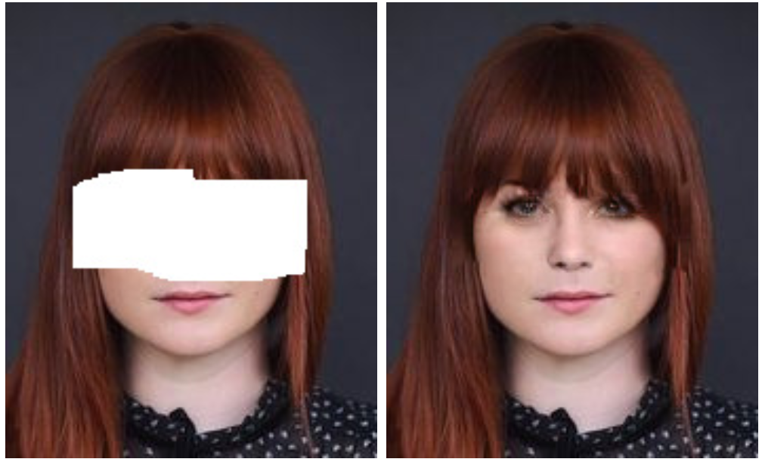
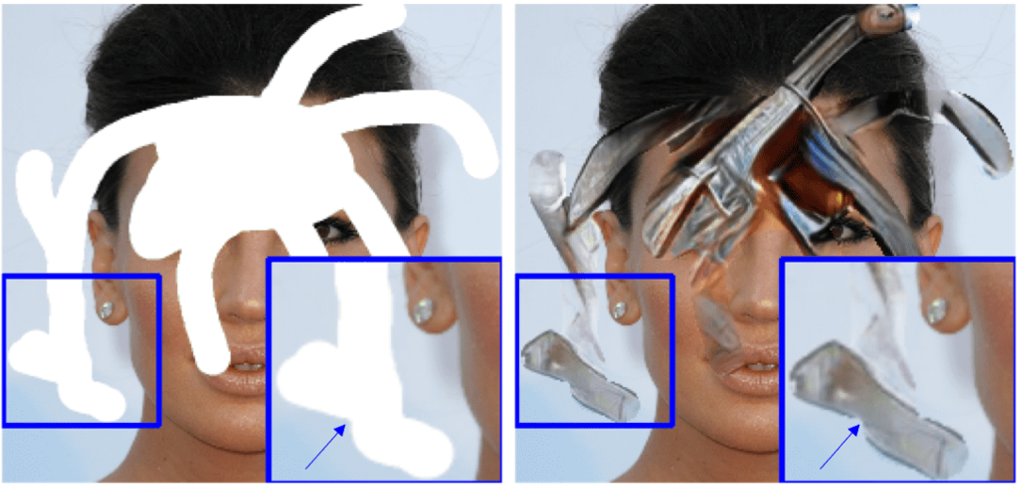
EVALUATION METRICS
Quantitative
MSE (Mean Squared Error)
PSNR (Peak Signal to Noise Ratio)
SSIM (Structural Similarity)
Image inpainting 是一个 ill-posed problem，即存在多种合理的填充方式
Qualitative
User study

Slide 8
3 MODELS

Slide 9
MODELS – Common things
Architecture
Generator:
Encoder-decoder
U-Net
Discriminator:
Global discriminator
Local discriminator / PatchGAN
Loss
Reconstruction loss
L1 loss → weighted
L2 loss
Adversarial loss (GAN loss)
Perceptual loss: VGG
Style loss: Gram matrix
ID-MRF loss
TV loss

Slide 10
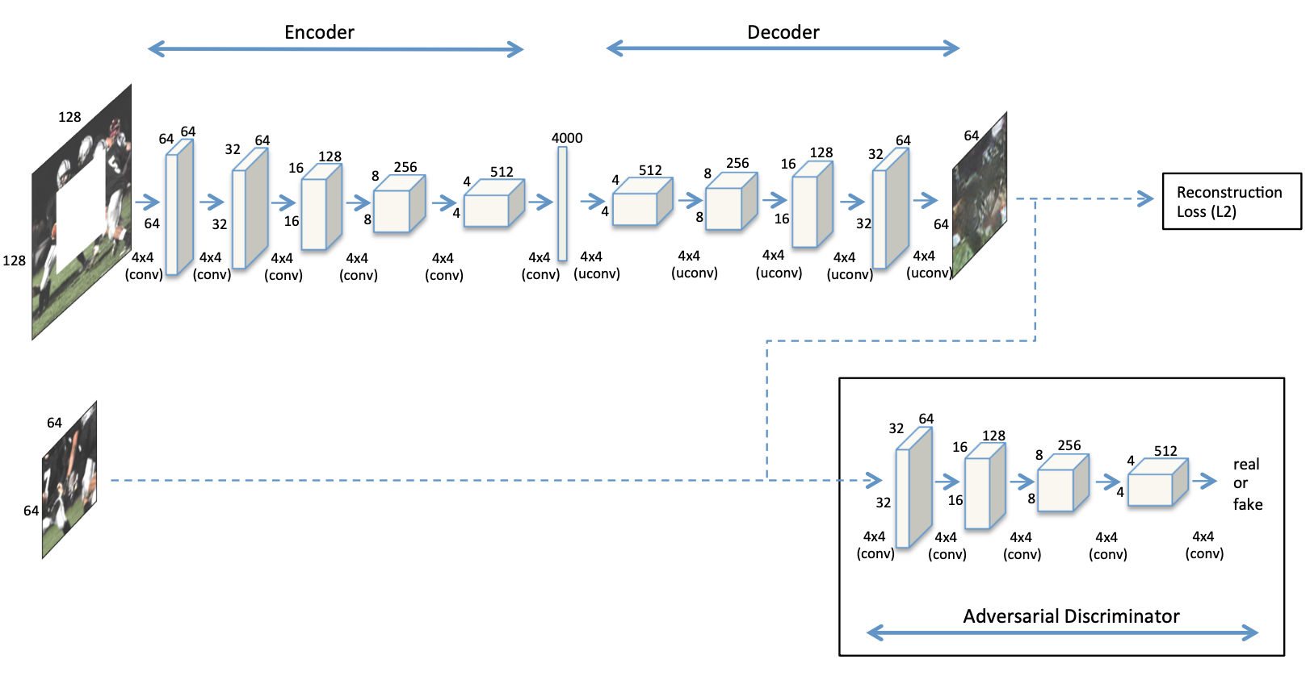
MODELS: Context Encoder
Encoder-decoder
Channel-wise fc
探讨 L2 loss 导致模糊的原因：L2 loss 倾向于给出较为平均化的结果，这样平均误差小并且较“安全”
固定 128x128 中的 64x64 缺失区域，不够灵活
Channel-wise fc
Pathak, Deepak, Philipp Krahenbuhl, Jeff Donahue, Trevor Darrell, and Alexei A. Efros. "Context encoders: Feature learning by inpainting."
In Proceedings of the IEEE conference on computer vision and pattern recognition, pp. 2536-2544. 2016.

Slide 11
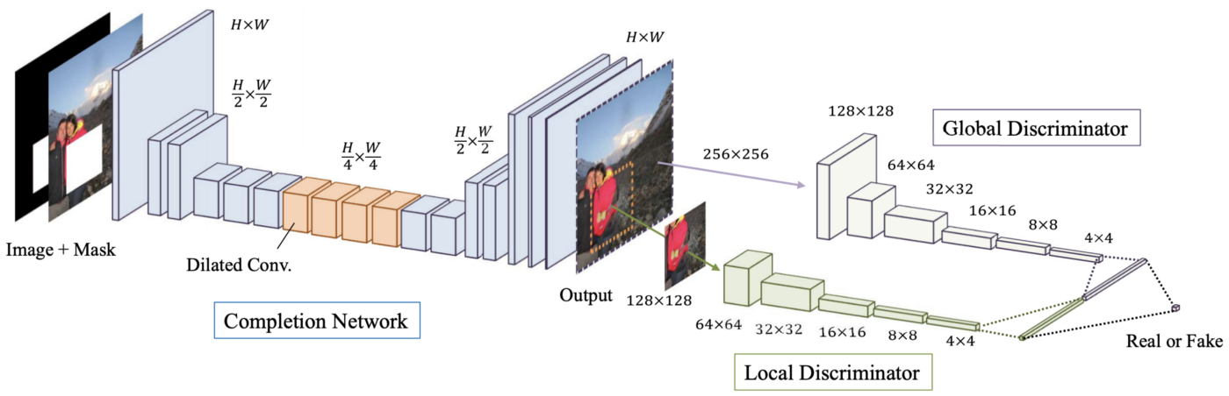
MODELS: GLCIC (GLGAN)
FCN with dilated conv
Global discriminator
Local discriminator
Local discriminator 只能接受一个缺失区域
训练与测试的不一致
Iizuka, Satoshi, Edgar Simo-Serra, and Hiroshi Ishikawa. "Globally and locally consistent image completion." ACM Transactions on Graphics (ToG) 36, no. 4 (2017): 1-14.

Slide 12
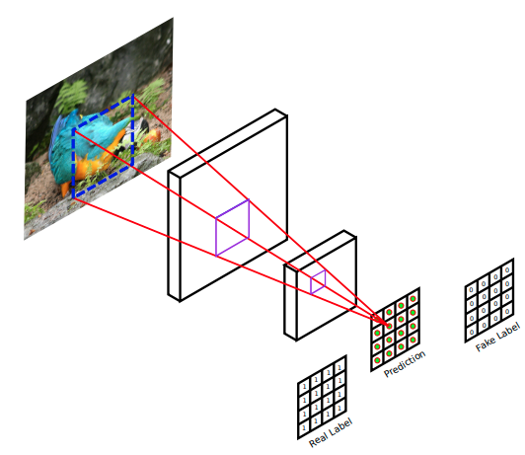
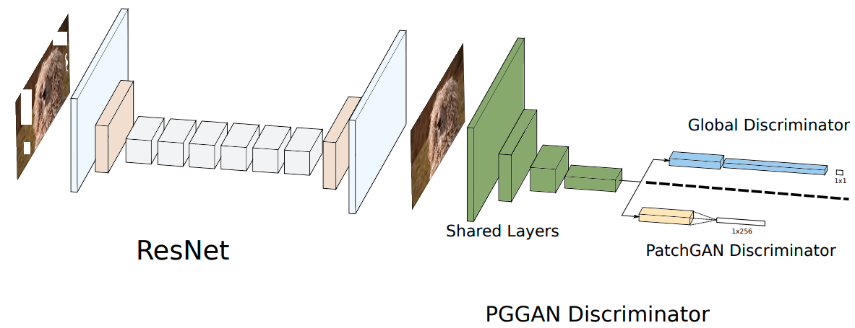
MODELS: PGGAN
PatchGAN & GlobalGAN
Dilated residual block
Local discriminator → PatchGAN discriminator
Demir, Ugur, and Gozde Unal. "Patch-based image inpainting with generative adversarial networks." arXiv preprint arXiv:1803.07422 (2018).

Slide 13
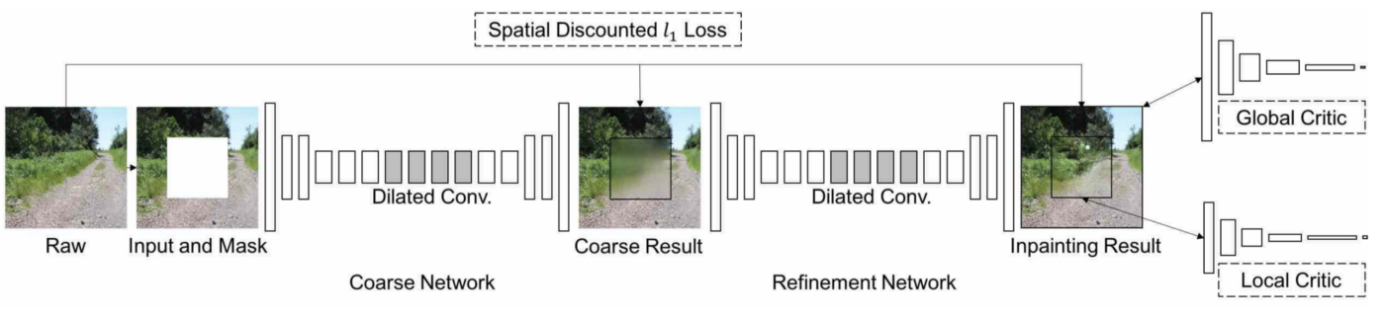
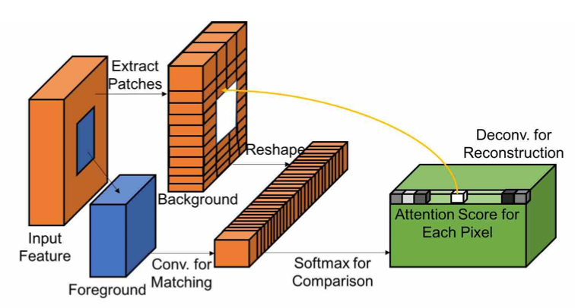
MODELS: Contextual Attention (DeepFill v1)
Contextual Attention
Spatially discounted L1 loss
Coase-to-fine two-stage
Yu, Jiahui, Zhe Lin, Jimei Yang, Xiaohui Shen, Xin Lu, and Thomas S. Huang. "Generative image inpainting with contextual attention."
In Proceedings of the IEEE conference on computer vision and pattern recognition, pp. 5505-5514. 2018.

Slide 14
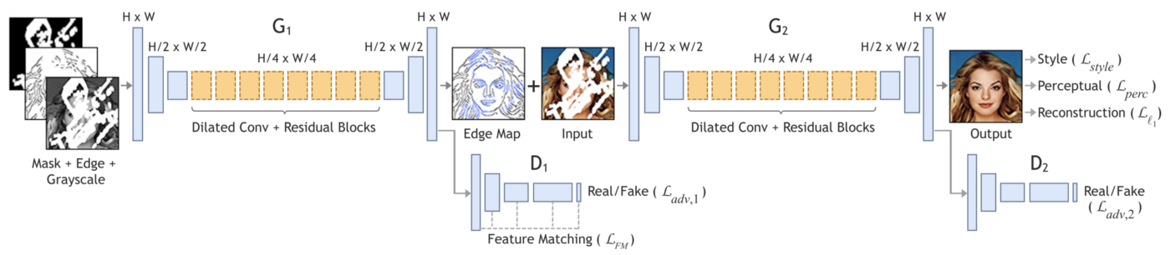
MODELS: EdgeConnect
Lines first, color next
Edge map 是一种先验信息
Nazeri, Kamyar, Eric Ng, Tony Joseph, Faisal Z. Qureshi, and Mehran Ebrahimi. "Edgeconnect: Generative image inpainting with adversarial edge learning." arXiv preprint arXiv:1901.00212 (2019).

Slide 15
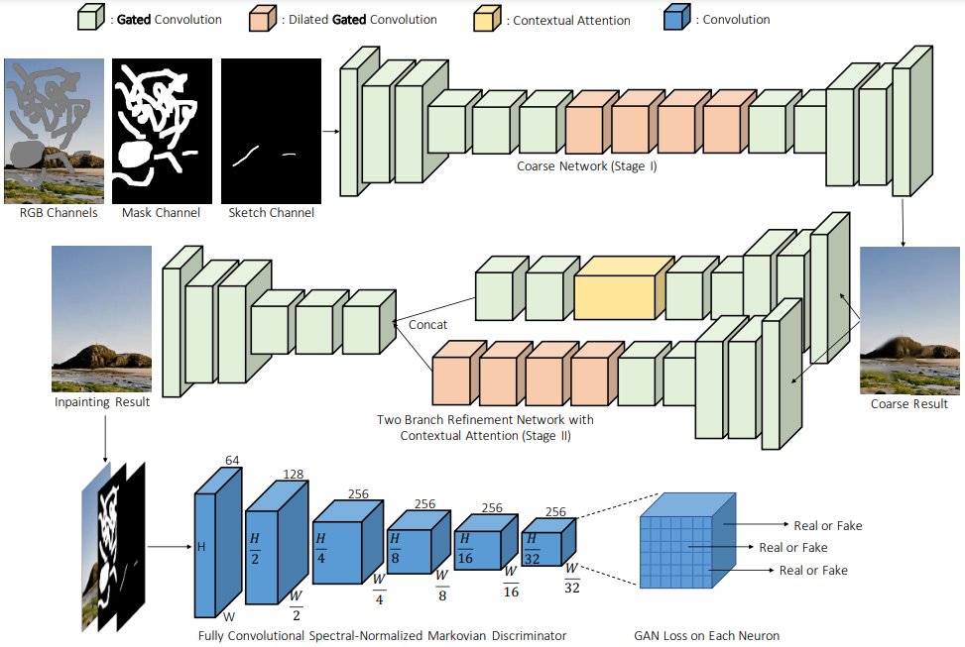
MODELS: DeepFill v2
Gated convolution
DeepFill v1 +
Partial conv +
EdgeConnect +
PatchGAN
Yu, Jiahui, Zhe Lin, Jimei Yang, Xiaohui Shen, Xin Lu, and Thomas S. Huang. "Free-form image inpainting with gated convolution.”
In Proceedings of the IEEE/CVF International Conference on Computer Vision, pp. 4471-4480. 2019.

Slide 16
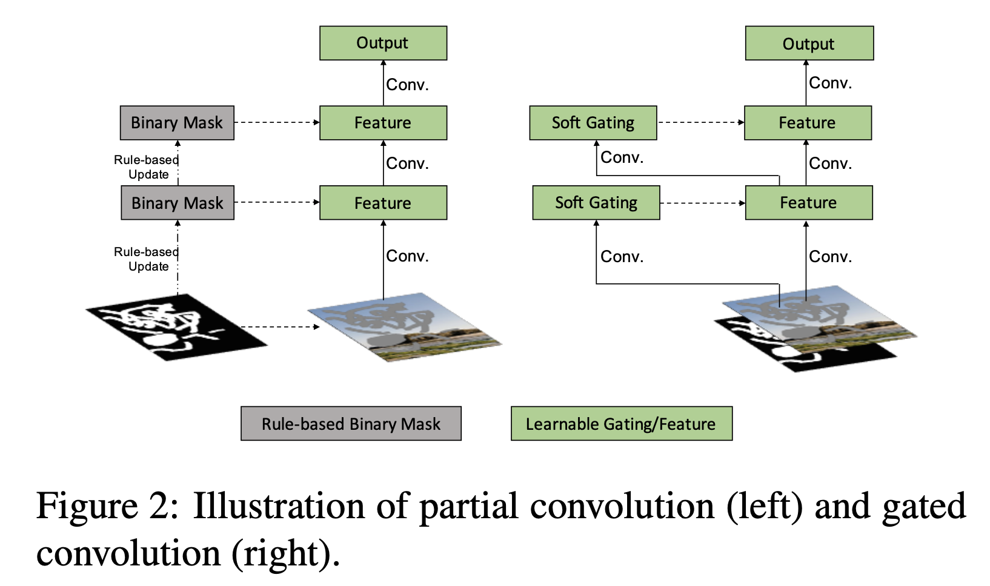
MODELS: DeepFill v2
Gated convolution
DeepFill v1 +
Partial conv +
EdgeConnect +
PatchGAN
Yu, Jiahui, Zhe Lin, Jimei Yang, Xiaohui Shen, Xin Lu, and Thomas S. Huang. "Free-form image inpainting with gated convolution.”
In Proceedings of the IEEE/CVF International Conference on Computer Vision, pp. 4471-4480. 2019.

Slide 17
4 BLIND - VCNet

Slide 18
BLIND IMAGE INPAINTING
Image inpainting 要求输入精确的缺失区域 mask，这导致它的实际应用场景局限在 object removal
Blind image inpainting 在 inference 阶段不要求提供 mask 信息
网络的输入没有 mask

Slide 19
BLIND: VCNet
Introduction
Highly ill-posed:
The unknown degraded regions need to be located based on their differences from the intact ones instead of their known characteristics.
Training data collection:
Damage should be diverse and complicated enough so that the high-level of structure inconsistency instead of the pattern in damage can be extracted.
Natural images are adopted as the filling content with random strokes.
Network structure:
Two stages: mask prediction & robust inpainting
Biggest issue: neutralize the generation degradation brought by inevitable mask estimation errors in the first stage
Probabilistic context normalization (PCN)

Slide 20
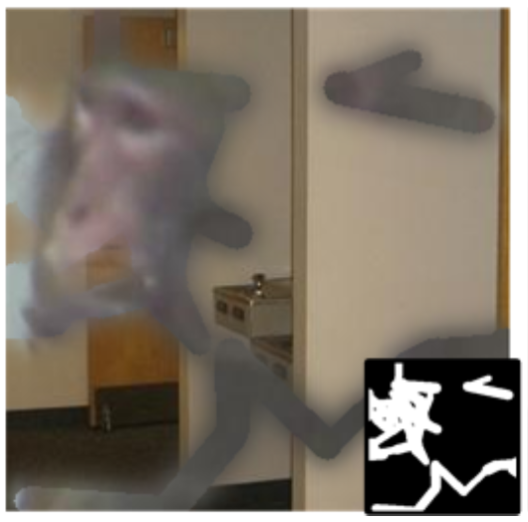
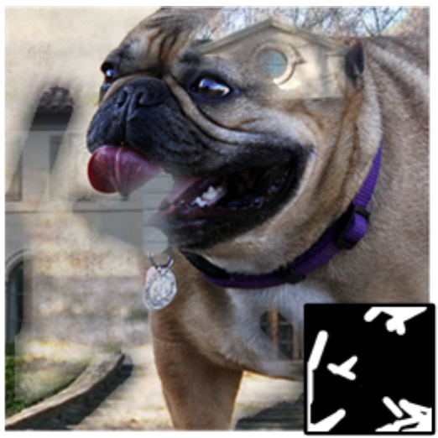
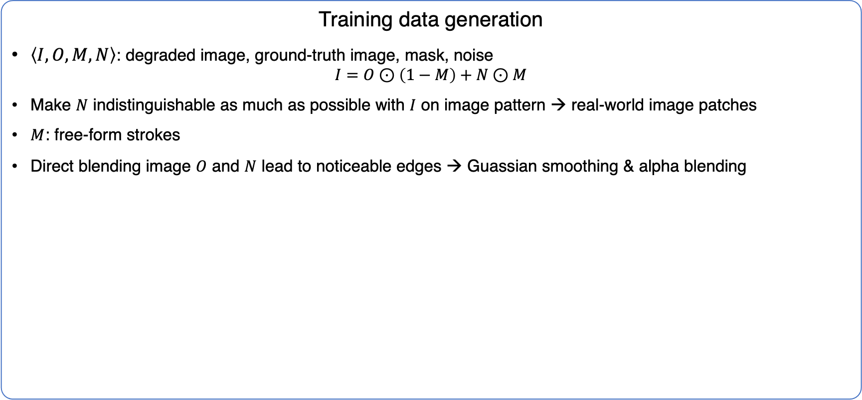
BLIND: VCNet
Training data generation
$\left\langle I, O, M, N\right\rangle$: degraded image, ground-truth image, mask, noise
$$I=O⊙\left(1−M\right)+N⊙M$$
Make $N$ indistinguishable as much as possible with $I$ on image pattern → real-world image patches
$M$: free-form strokes
Direct blending image $O$ and $N$ lead to noticeable edges → Guassian smoothing & alpha blending

Slide 21
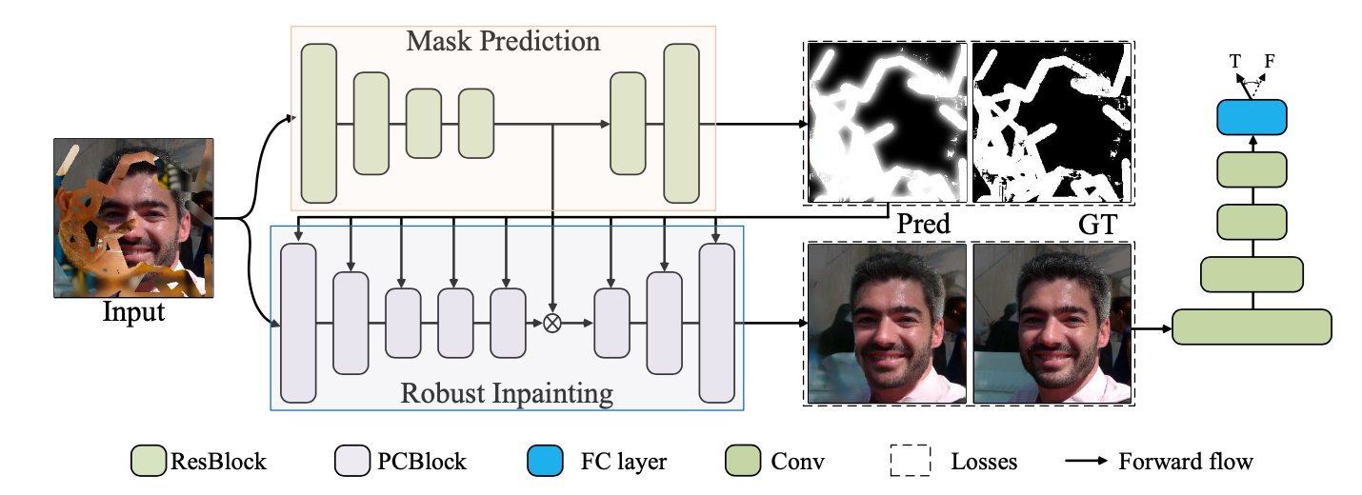
BLIND: VCNet
Method
Visual Consistent Network (VCNet)
Mask Prediction Network (MPN) + Robust Inpainting Network (RIN)

Slide 22
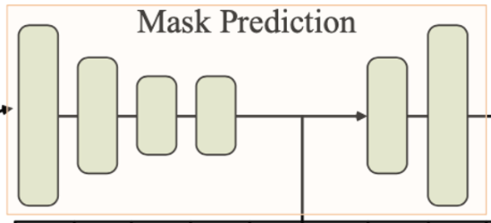
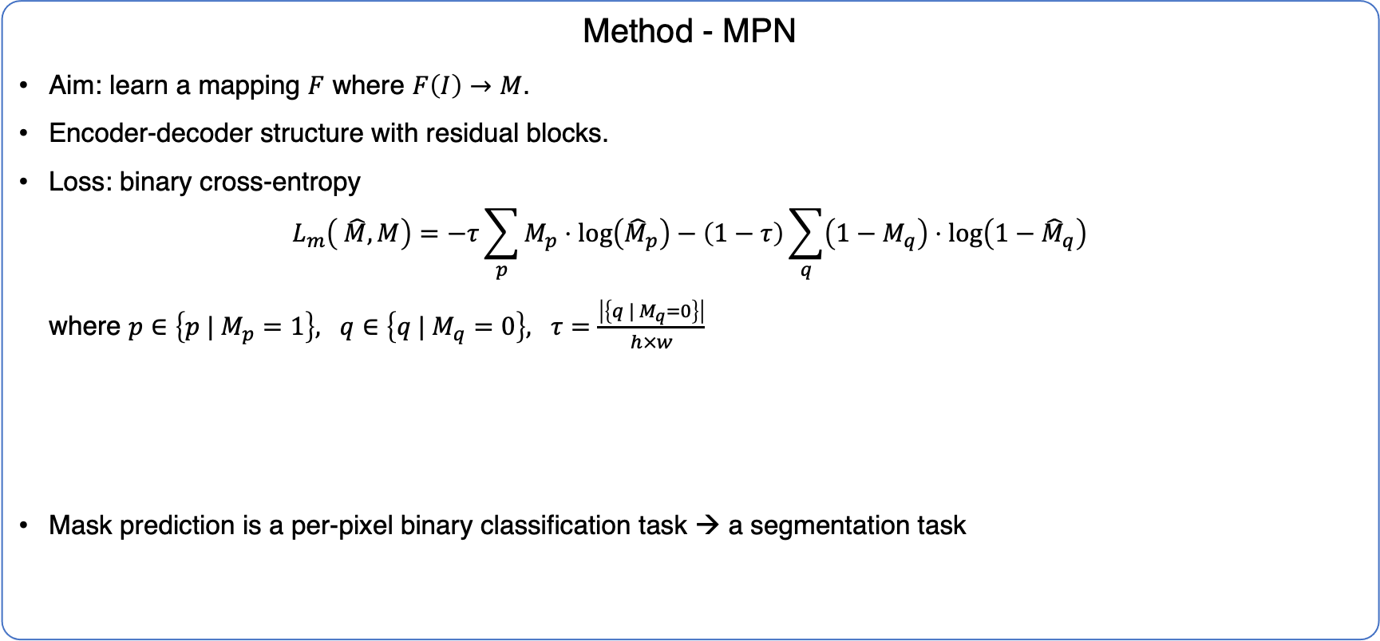
BLIND: VCNet
Method - MPN
Aim: learn a mapping $F$ where $F\left(I\right)→M$.
Encoder-decoder structure with residual blocks.
Loss: binary cross-entropy
$$L_{m}\left( \hat{M},M\right)=−τ\sum_{p}{M_{p}⋅\log\left({\hat{M}}_{p}\right)}−\left(1−τ\right)\sum_{q}{\left(1−M_{q}\right)⋅\log\left(1−{\hat{M}}_{q}\right)}$$
where $p∈\left\{p | M_{p}=1\right\}, q∈\left\{q | M_{q}=0\right\}, τ=\frac{\left|\left\{q | M_{q}=0\right\}\right|}{h×w}$
Mask prediction is a per-pixel binary classification task → a segmentation task

Slide 23
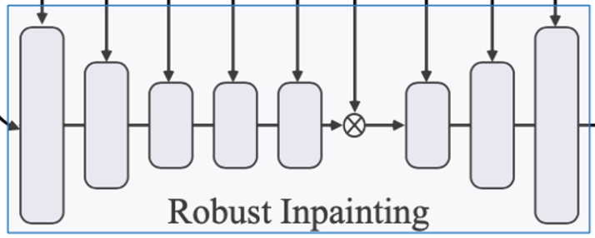
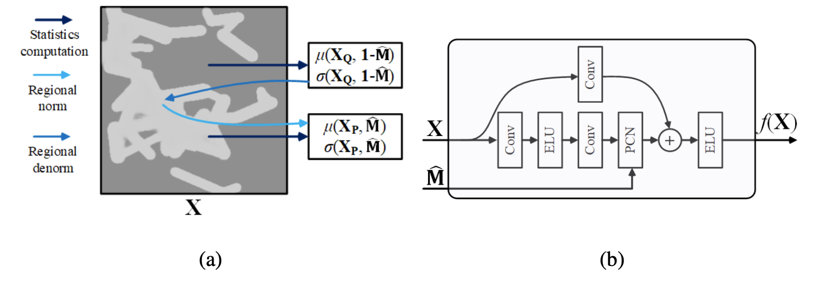
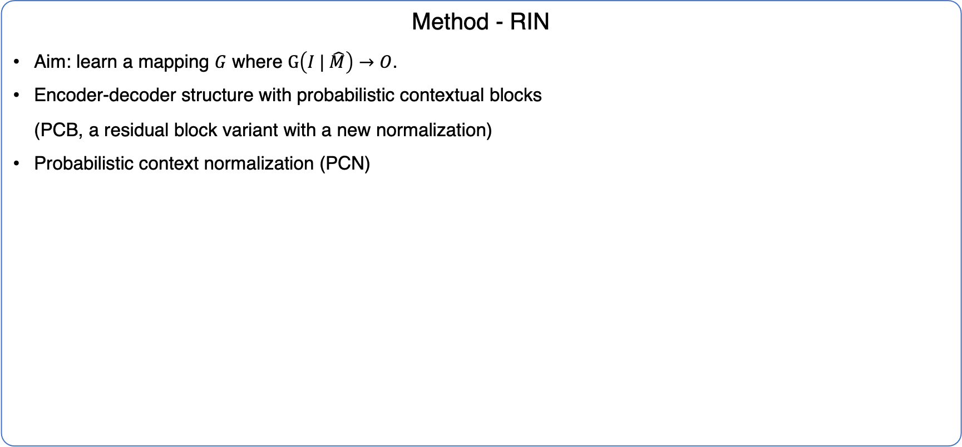
BLIND: VCNet
Method - RIN
Aim: learn a mapping $G$ where $G\left(I | \hat{M}\right)→O$.
Encoder-decoder structure with probabilistic contextual blocks
(PCB, a residual block variant with a new normalization)
Probabilistic context normalization (PCN)

Slide 24
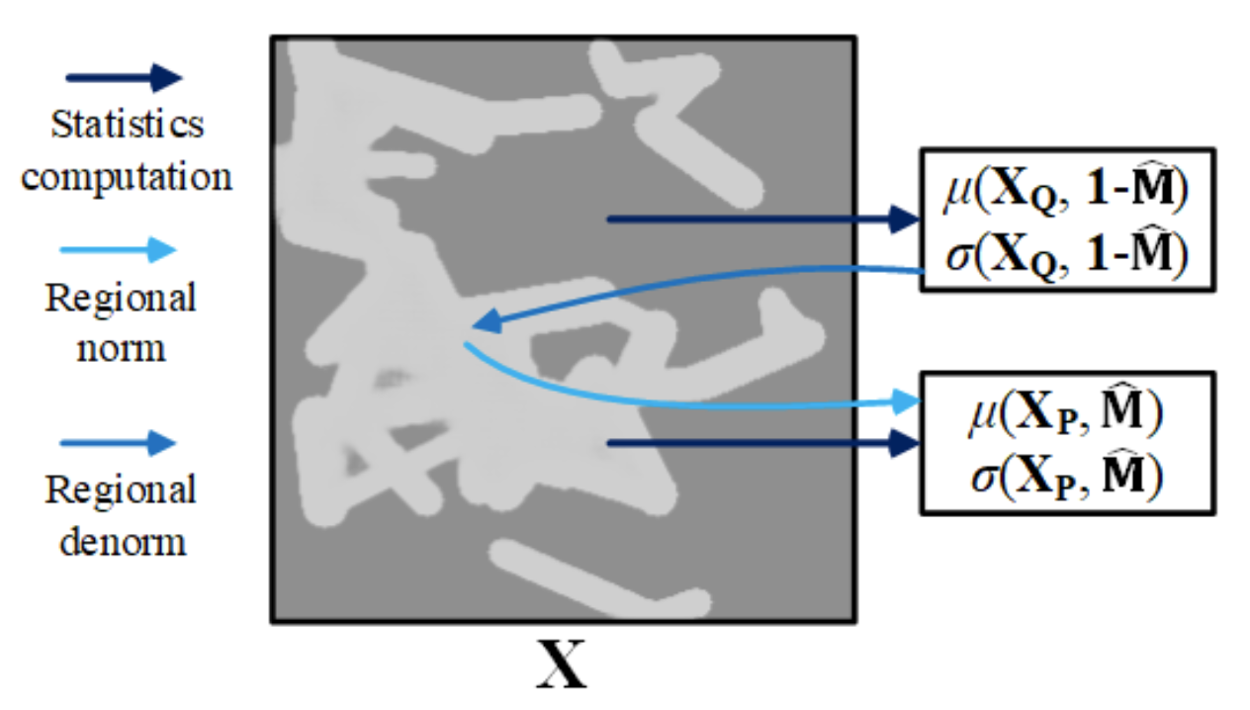
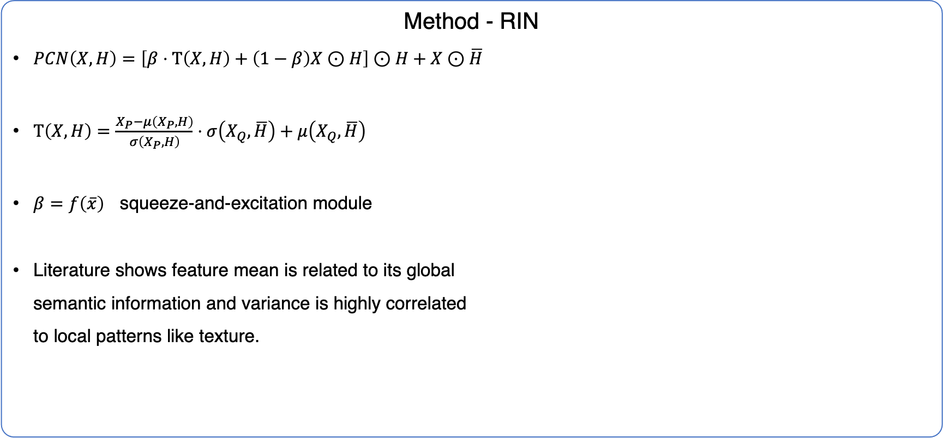
BLIND: VCNet
Method - RIN
$PCN\left(X, H\right)=\left[β⋅Τ\left(X, H\right)+\left(1−β\right)X⊙H\right]⊙H+X⊙\overline{H}$
$Τ\left(X, H\right)=\frac{X_{P}−μ\left(X_{P},H\right)}{σ\left(X_{P}, H\right)}⋅σ\left(X_{Q}, \overline{H}\right)+μ\left(X_{Q}, \overline{H}\right)$
$β=f\left(\overline{x}\right)$ squeeze-and-excitation module
Literature shows feature mean is related to its global
semantic information and variance is highly correlated
to local patterns like texture.
Gatys, L.A., Ecker, A.S., Bethge, M.: Image style transfer using convolutional neural net- works. In: CVPR. pp. 2414–2423 (2016)
Johnson, J., Alahi, A., Fei-Fei, L.: Perceptual losses for real-time style transfer and super-resolution. In: ECCV. pp. 694–711 (2016)

Slide 25
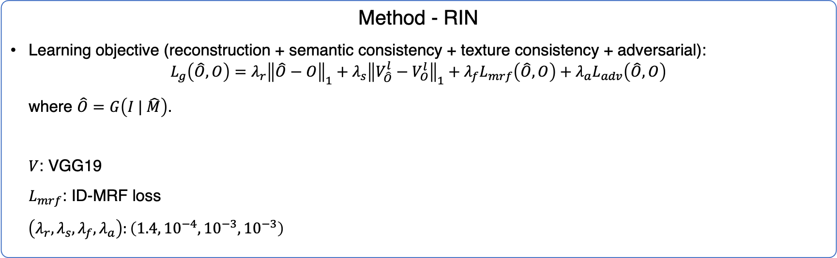
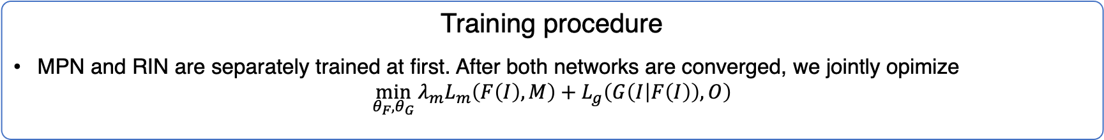
BLIND: VCNet
Method - RIN
Learning objective (reconstruction + semantic consistency + texture consistency + adversarial):
$$L_{g}\left(\hat{O},O\right)=λ_{r}{\left\|\hat{O}−O\right\|}_{1}+λ_{s}{\left\|V_{\hat{O}}^{l}−V_{O}^{l}\right\|}_{1}+λ_{f}L_{mrf}\left(\hat{O}, O\right)+λ_{a}L_{adv}\left(\hat{O},O\right)$$
where $\hat{O}=G\left(I | \hat{M}\right)$.
$V$: VGG19
$L_{mrf}$: ID-MRF loss
$\left(λ_{r},λ_{s},λ_{f},λ_{a}\right):\left(1.4, {10}^{−4},{10}^{−3},{10}^{−3}\right)$
Training procedure
MPN and RIN are separately trained at first. After both networks are converged, we jointly opimize
$$\min_{θ_{F},θ_{G}}{λ_{m}L_{m}\left(F\left(I\right),M\right)+L_{g}\left(G\left(I | F\left(I\right)\right),O\right)}$$

Slide 26
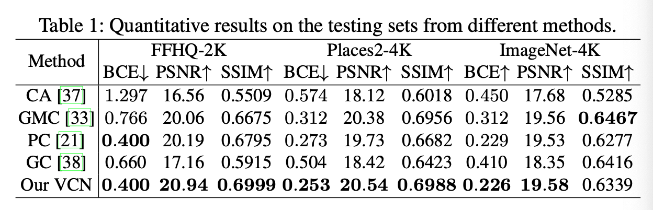
BLIND: VCNet
Experimental results
Contextual Attention, Multi-column, PartialConv, GatedConv (DeepFill v2)
Equipped with MPN in front of their inputs, trained from scratch.
Quantitative results

Slide 27
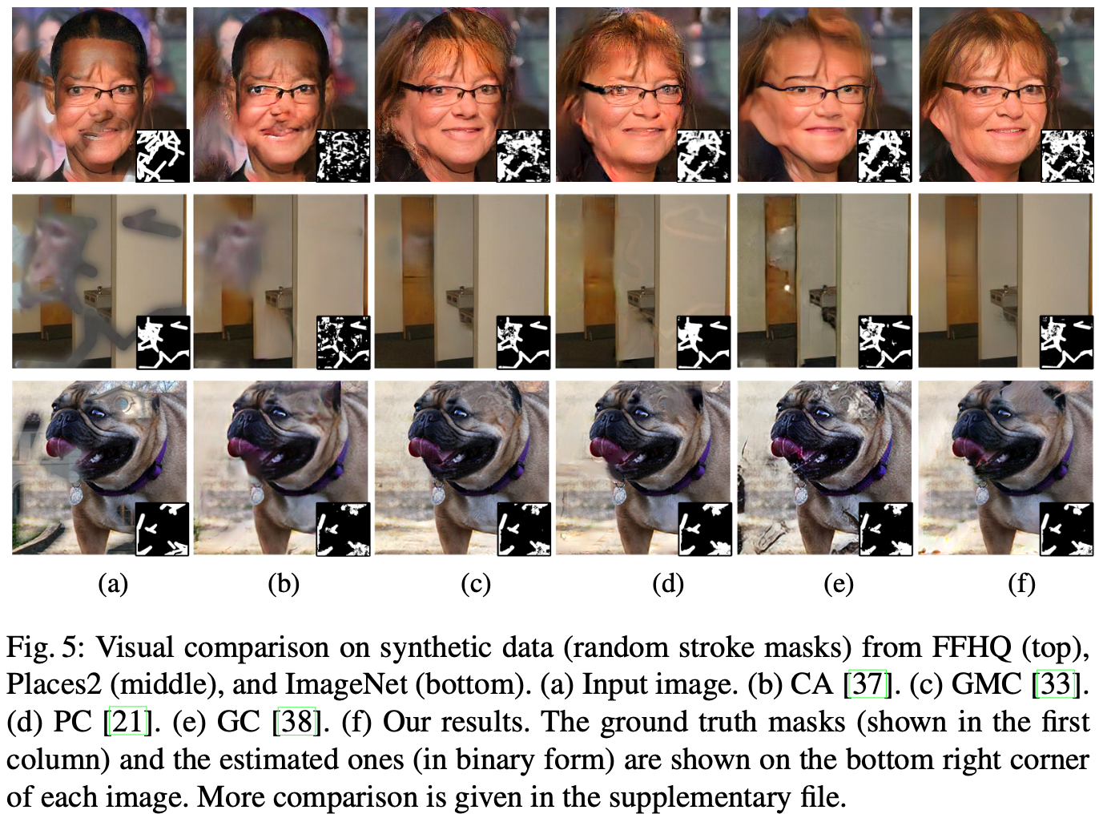
BLIND: VCNet
Experimental results
Qualitative results

Slide 28
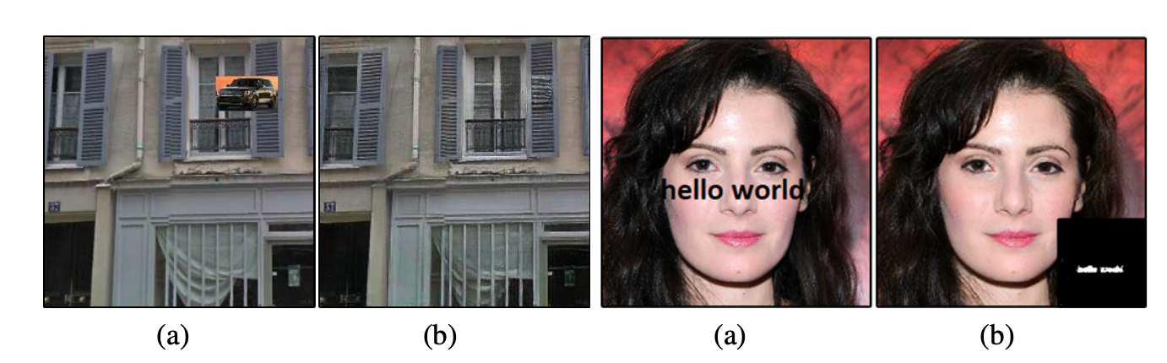
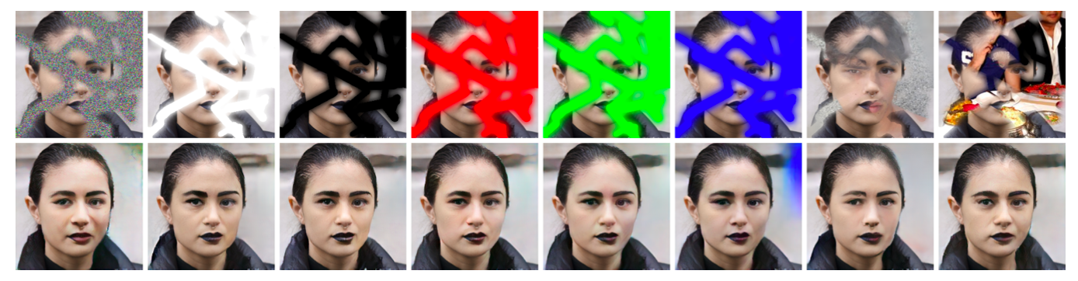
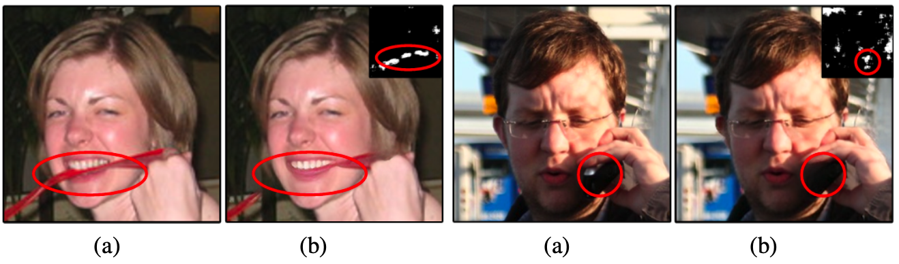
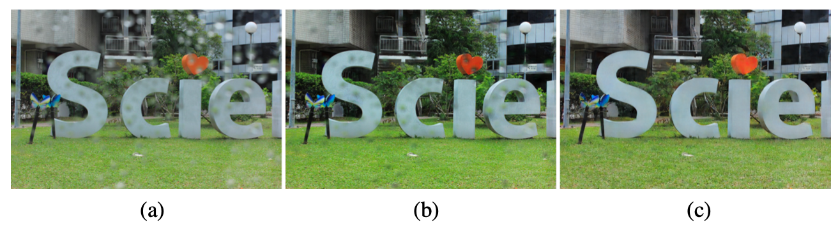
BLIND: VCNet
Experimental results

Slide 29
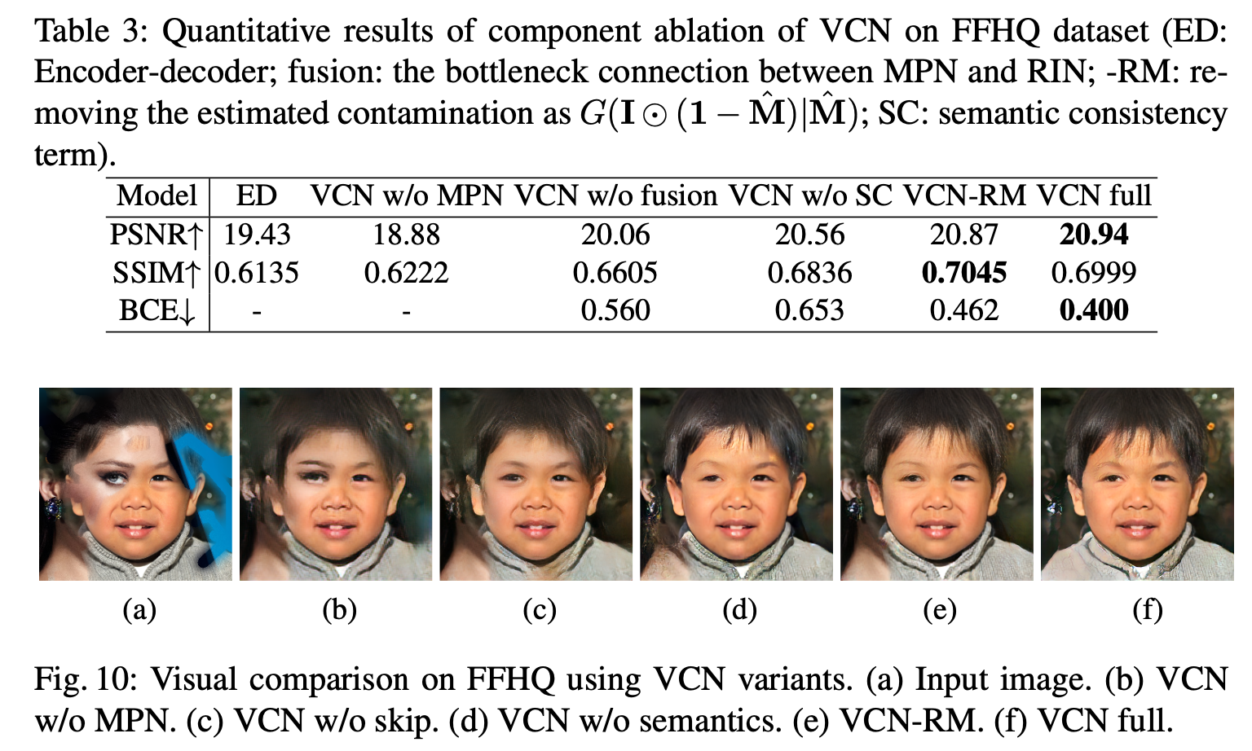
BLIND: VCNet
Experimental results
Ablation

Slide 30
BLIND: VCNet
VCNet
PGGAN
EdgeConnect
Notes:
PGGAN 如果不给 mask 输入，已经能够完成 blind image inpainting 任务了
PGGAN 与 VCNet 做对比，可以发现，后者在前者的基础上加了一个 mask prediction 过程，随后再生成结果图
这个结构和 EdgeConnect 是一致的（虽然画的看起来不一样，但实际都是串行的），EdgeConnect 先生成 edge map，随后再生成结果图
EdgeConnect 的核心思想是 edge map 是一个很好的先验信息，那么把这个思想套在 VCNet 上，就是：mask 是一个很好的先验信息

Slide 31
5 THINKING

Slide 32
Thinking…
由 dataset 引发的思考
Dataset
Paris StreetView / ImageNet / Places / CelebA + artificial distortion
Applications
Object removal——mask 可以人为构造
修复污染图像——人为构造的 mask 与污染形成的 mask 存在差异
Unpaired image inpainting?
训练时，也不提供 corrupted images 对应的 ground-truth images
Corrupted image domain → Uncorrupted image domain

Slide 33
Thinking…
由 reconstruction loss 引发的思考
L1 loss / L2 loss
Image inpainting 本身是一个 ill-posed problem，那么 reconstruction loss 的合理性值得质疑
Reconstruction loss 会导致生成的图像模糊，即对局部真实性有害
[Contextual Attention] Our conclusion is that the pixel-wise reconstruction loss, although tends to make the result blurry, is an essential ingredient for image inpainting. The reconstruction loss is helpful in capturing content structures and serves as a powerful regularization term for training GANs.
现有方法非常依赖于 reconstruction loss，能否找到只用 adversarial loss 的方式呢？

Slide 34
Thinking…
由 EdgeConnect 引发的思考
Edge map 是一种先验
还有什么先验可以帮助 inpainting？例如语义分割图？
由 ill-posed 引发的思考
能否让同一个模型输出不同的、但都合理的填充图像？

Slide 35
THE END

